Slide 1

MoDist: Motion Distillation for Self-supervised Video Representation Learning
Fanyi Xiao, Joseph Tighe, Davide Modolo

Slide 2

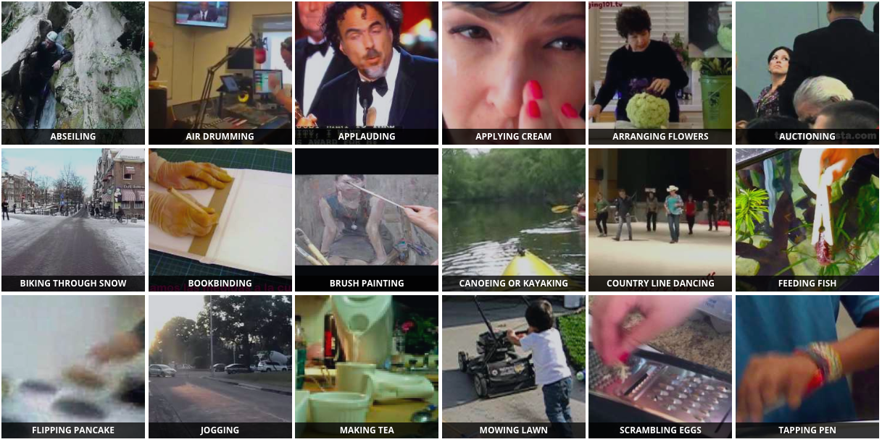
Why self-supervised?
ImageNet -- 1.2M images with 1000 classes
Kinetics 400 -- 240k videos with 400 classes
Jia Deng et al. 2009
Will Kay et al. 2017
It’s very expensive to label large-scale datasets, particularly for videos!

Slide 3
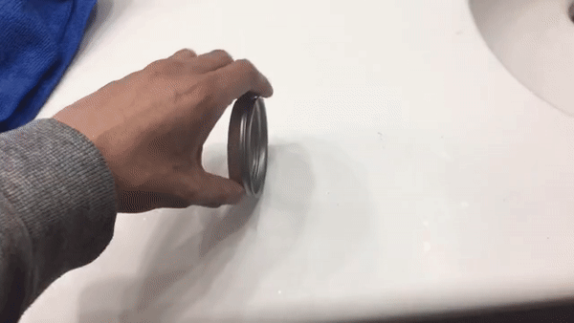
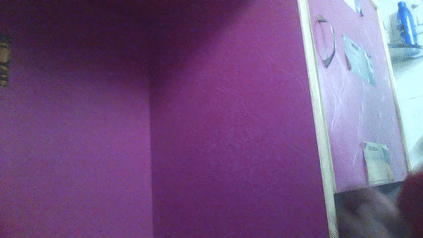
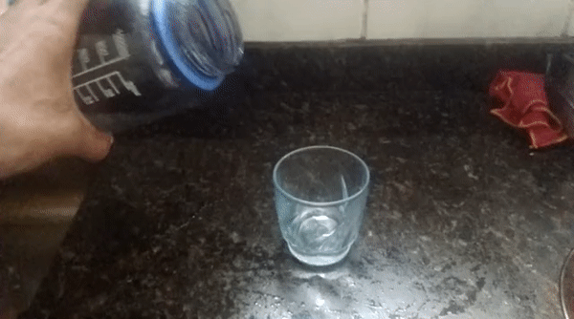
Why self-supervised?
Spinning a bracelet so it continues spinning
Pulling two ends of a rubber band so that it gets stretched
Large domain gap
Trying to pour water into a glass, but missing so it spills next to it
Pretrain on Kinetics 400
Finetune on Something-Something
Self-supervised learning helps avoid taxonomy bias, which is inevitable with supervised pretraining.

Slide 4
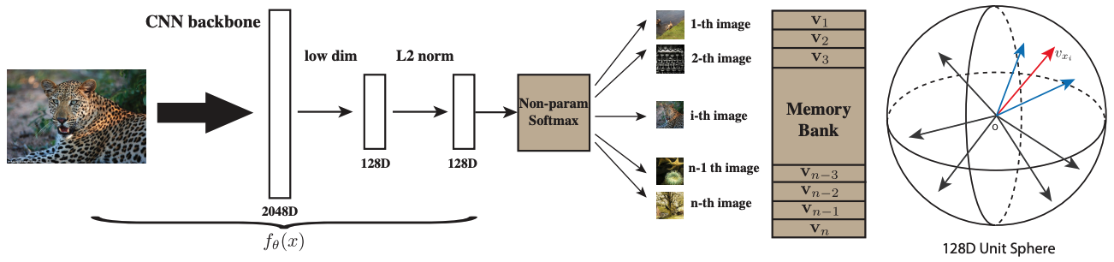
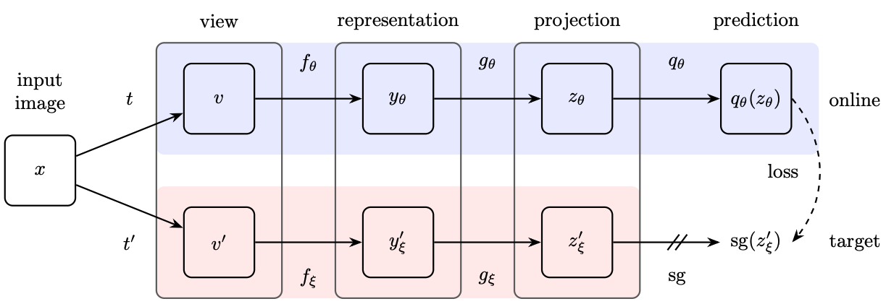
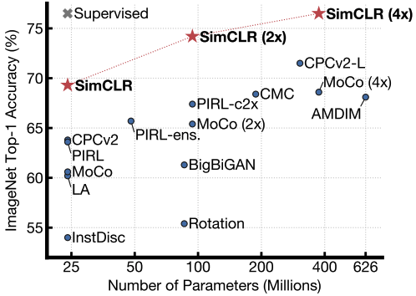
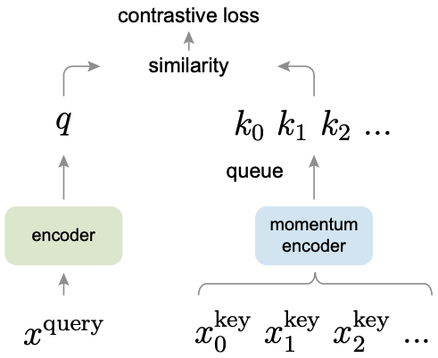
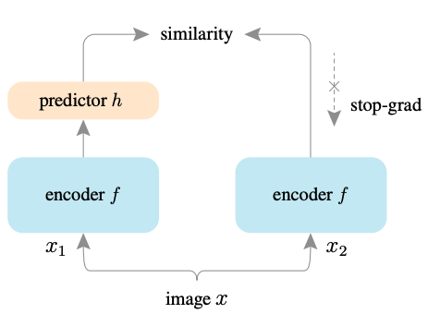
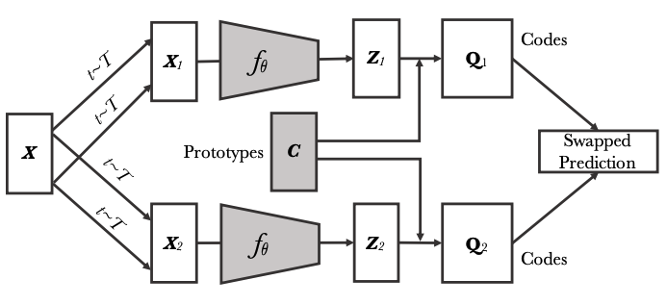
Self-supervised Contrastive Learning
[Instance Discrimination, Wu et al CVPR 18’]
[BYOL, Grill et al 20’]
[SwAV, Caron et al 20’]
[SimCLR, Chen et al ICML 20’]
[MoCo, He et al CVPR 20’]
[SimSiam, Grill et al 20’]
Self-supervised Contrastive Learning has been proven to match supervised pretraining on many image tasks.

Slide 5
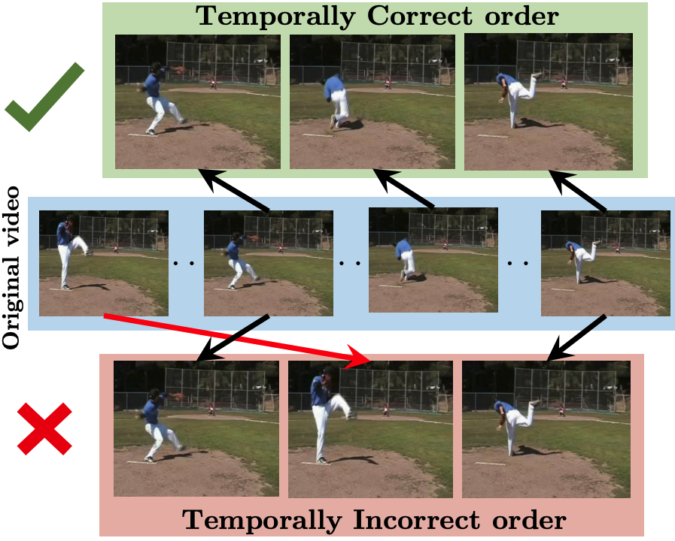
Videos provide richer signals for self-supervised learning
Shuffle&Learn [ECCV 16]
Videos provide rich temporal structure to be exploited for self-supervision

Slide 6
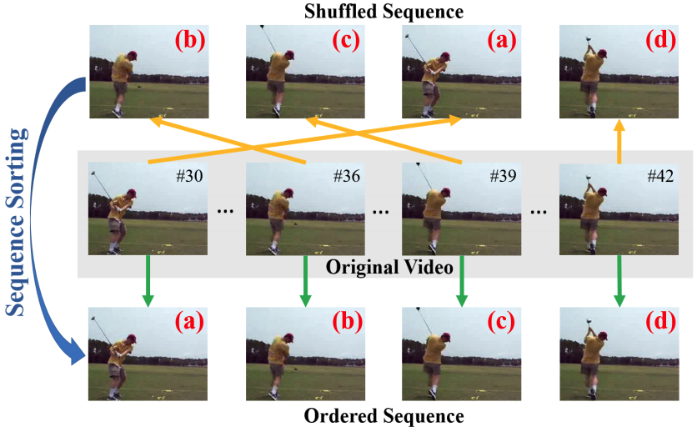
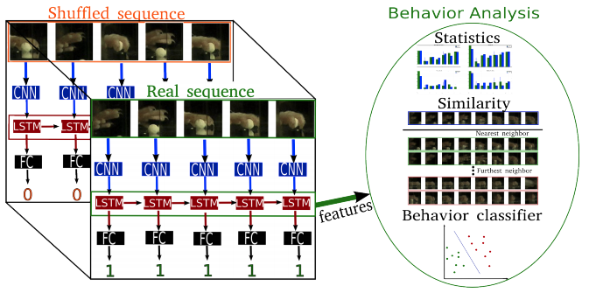
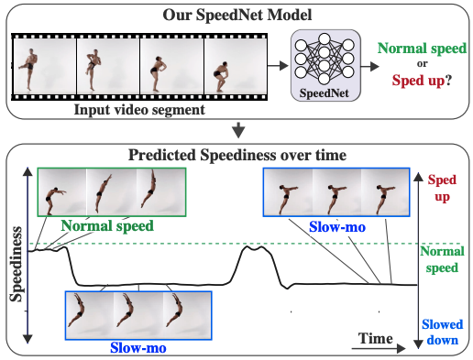
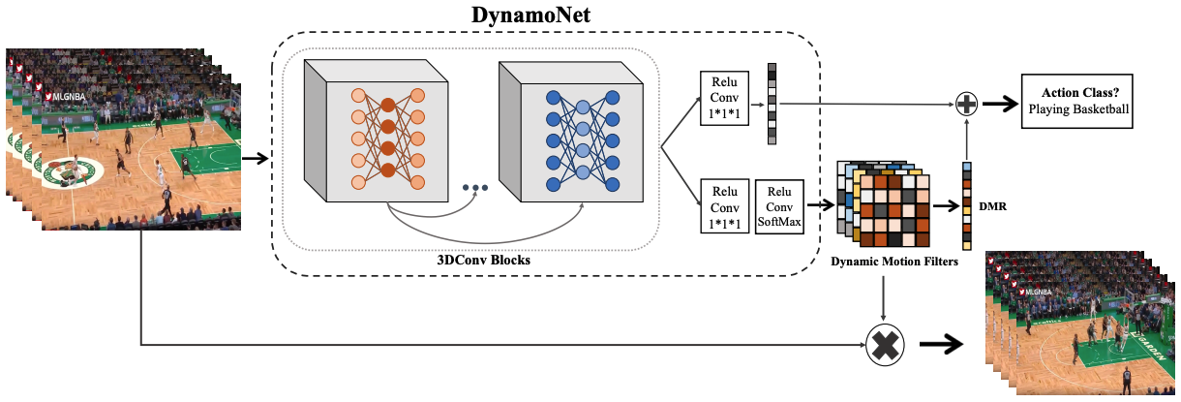
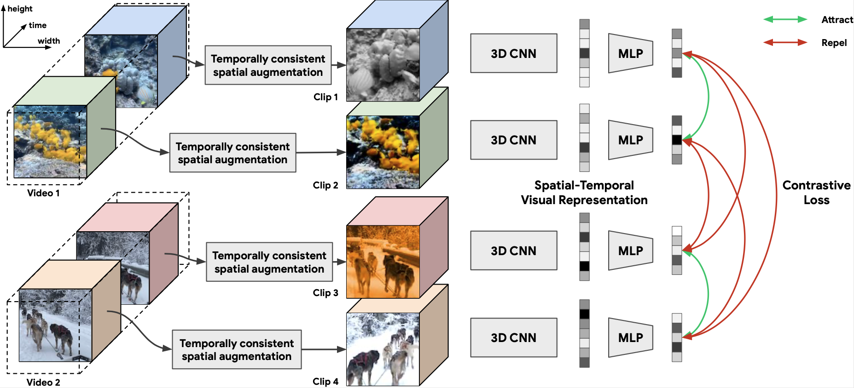
Self-supervised Video Representation Learning
Brattoli et al. [CVPR 17]
OPN [ICCV 17]
Shuffle&Learn [ECCV 16]
DynamoNet [ICCV 19]
CVRL [CVPR 21]
SpeedNet [CVPR 20]
Notes:
First three work uses human defined “pretext” task, which might not be optimal for learning useful representations

Slide 7
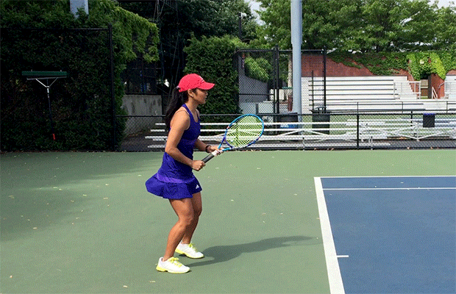
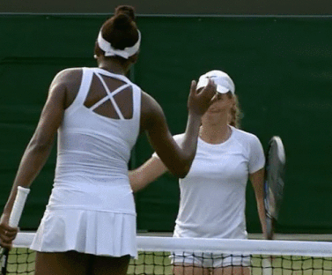

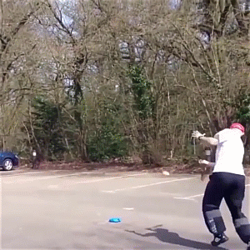
Motivation: Motion modeling is important for video representations
GT: Greeting
Pred: Playing Tennis
GT: Playing Tennis
GT: Playing Tennis
Pred: Parking Car
Training
Supervised motion modeling for videos:
[Feichtenhofer et al., NeurIPS 2016]
[Feichtenhofer et al., CVPR 2016]
Testing
[Wang et al., ECCV 2016]
…….

Slide 8
Approach

Slide 9
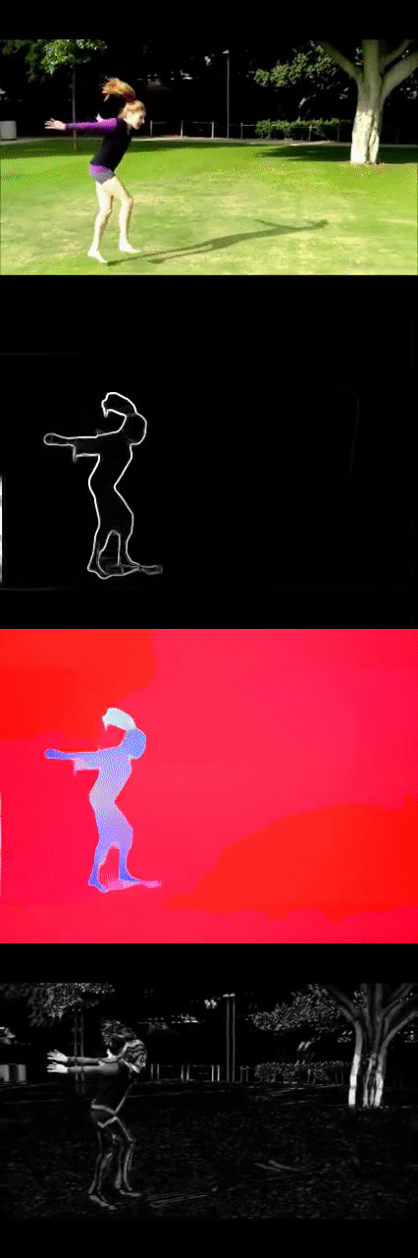

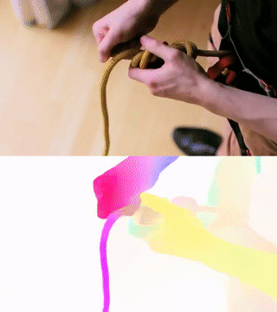
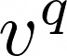
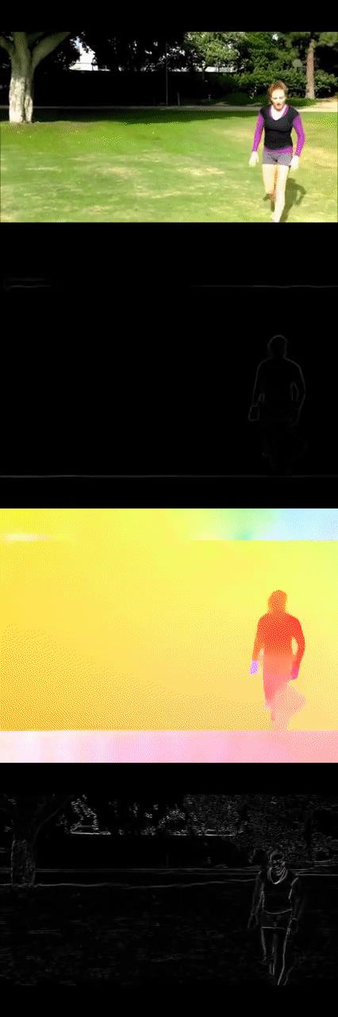
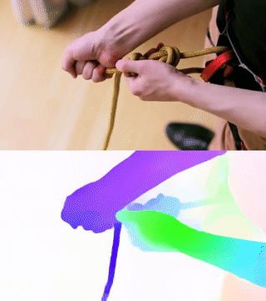
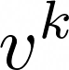
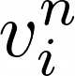
Visual-to-Visual Contrastive Learning
Visual CNN
Visual CNN
Visual CNN
Visual CNN
Repeal
Attract
We adopt a visual-to-visual contrastive learning objective operating on RGB clips

Slide 10
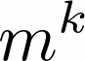
Motion-to-Visual Distillation Learning
Repeal (V2V)
Attract (V2V)
Motion CNN
Repeal (MV)
Attract (MV)
Visual CNN
Visual CNN
Visual CNN
Visual CNN
Motion CNN
We enrich visual-only learning with Motion-to-Visual distillation objective

Slide 11
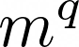
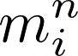
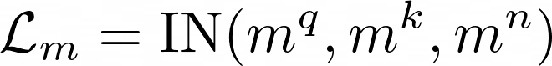
Motion-to-Motion Contrastive Learning
Motion CNN
Motion CNN
We combine these three losses to form our final learning objective:
Motion CNN
Motion CNN
Repeal (M2M)
Attract (M2M)
We further add a Motion-to-Motion learning objective to improve discriminativeness of motion representations.

Slide 12
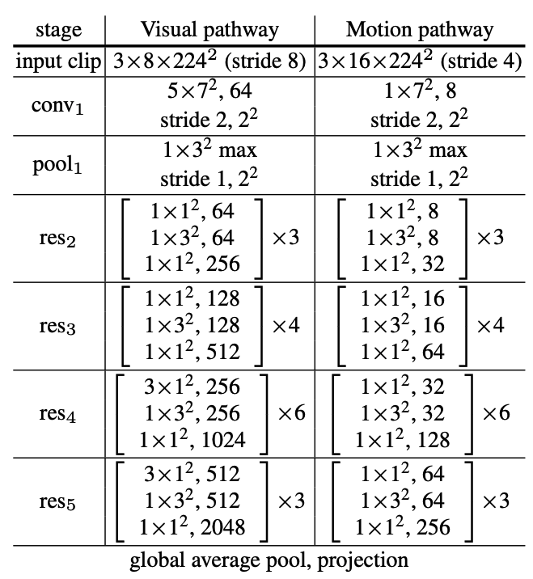
MoDist Network Architectures
Motion CNN
8x
Visual CNN
Visual CNN
Visual CNN
Visual CNN
Motion CNN
R50 backbone used for both pathways
Notes:
- Motion CNN is a much more lightweight network (1/8 of the channels for all layers compared to Visual CNN)
Visual CNN is a R3D-50 model with [5, 1, 1, 3, 3] temporal kernel for each ResNet stages, it takes in 8x8 inputs

Slide 13
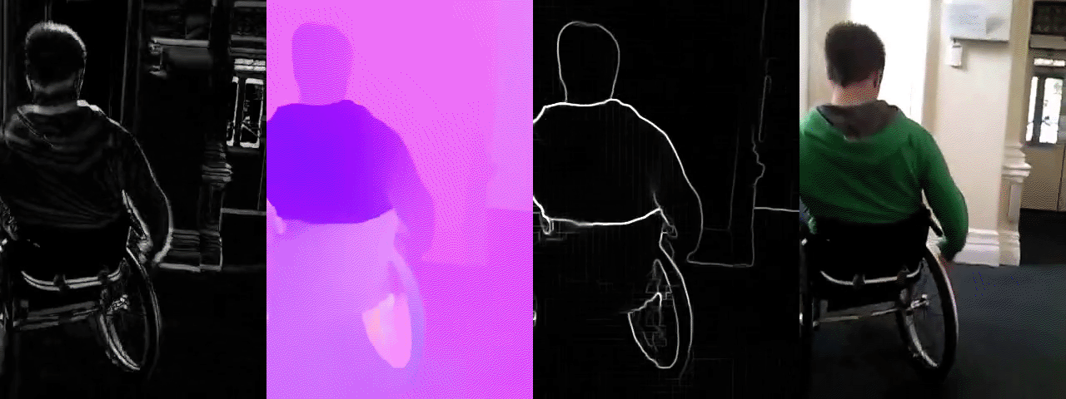
Design Motion Representations
(a)
(b)
(c)
(d)
From left to right: (a) Frame Difference (b) Optical Flow (c) Flow Edge (d) RGB inputs

Slide 14
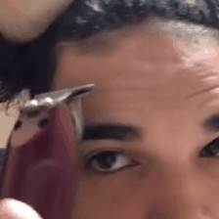
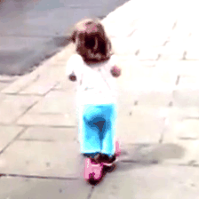

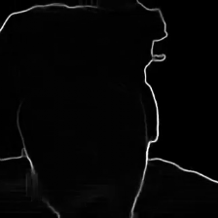
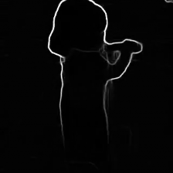
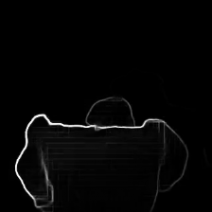
Flow edge maps with 16x4 sampling rate

Slide 15
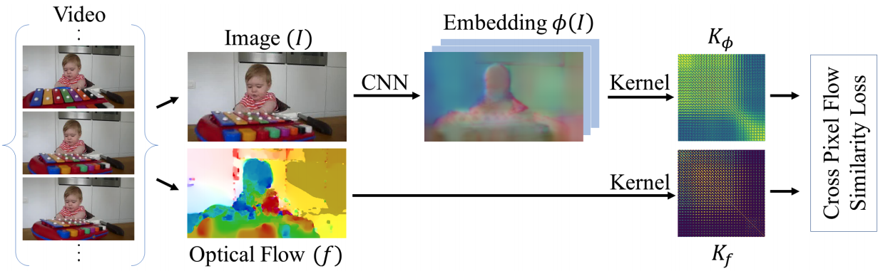
Sampling Inputs for Visual and Motion Networks
We apply temporal jittering to visual and motion clips to learn semantic abstraction of visual and motion patterns.
In-sync
w/o temporal jitter (V/F synced)
Out-of-sync
Visual input
w/ temporal jitter (V/F not sync)
[Mahendran et al. 18’]

Slide 16
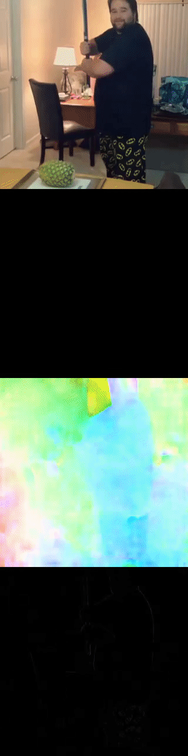
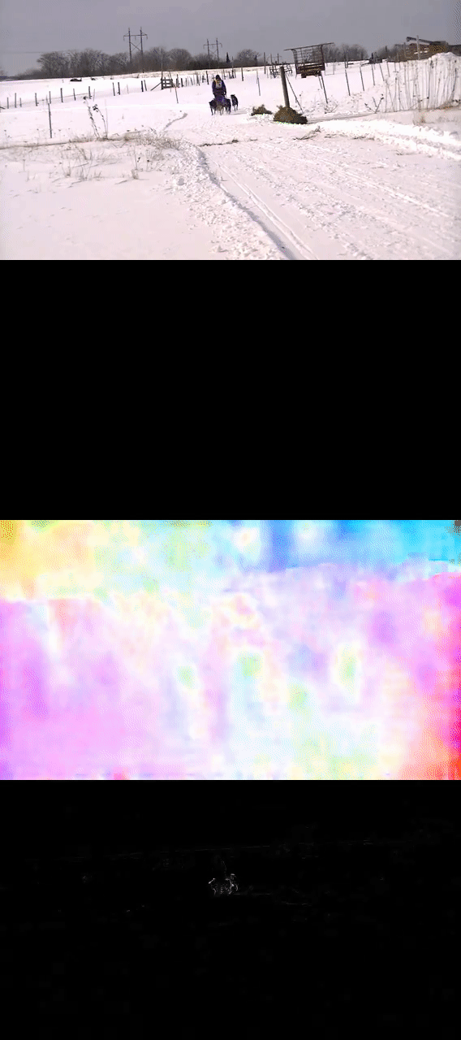
Sampling Inputs for Visual and Motion Networks
We apply temporal jittering to visual and motion clips to learn semantic abstraction of visual and motion patterns.
We apply a motion strength filter to avoid sampling from temporal windows with weak or no motion.
No motion due to static posture
Weak motion due to camera distance

Slide 17
Experiments

Slide 18
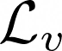
Training and Evaluating MoDist
We train on Kinetics-400 dataset of 240k clips of max length 10 secs. We do not use Kinetics labels.
With the pretrained representation, we transfer to target datasets and evaluate with Linear and Full protocols.
Across experiments, we compare to two important baselines:
RGB-only self-supervised contrastive learning (i.e., trained with only )
Supervised pretraining that utilizes Kinetics/ImageNet labels
Notes:
Protocol: SSL pretrain on K400 and then freeze the backbone and train a linear classifier on top for UCF/HMDB

Slide 19
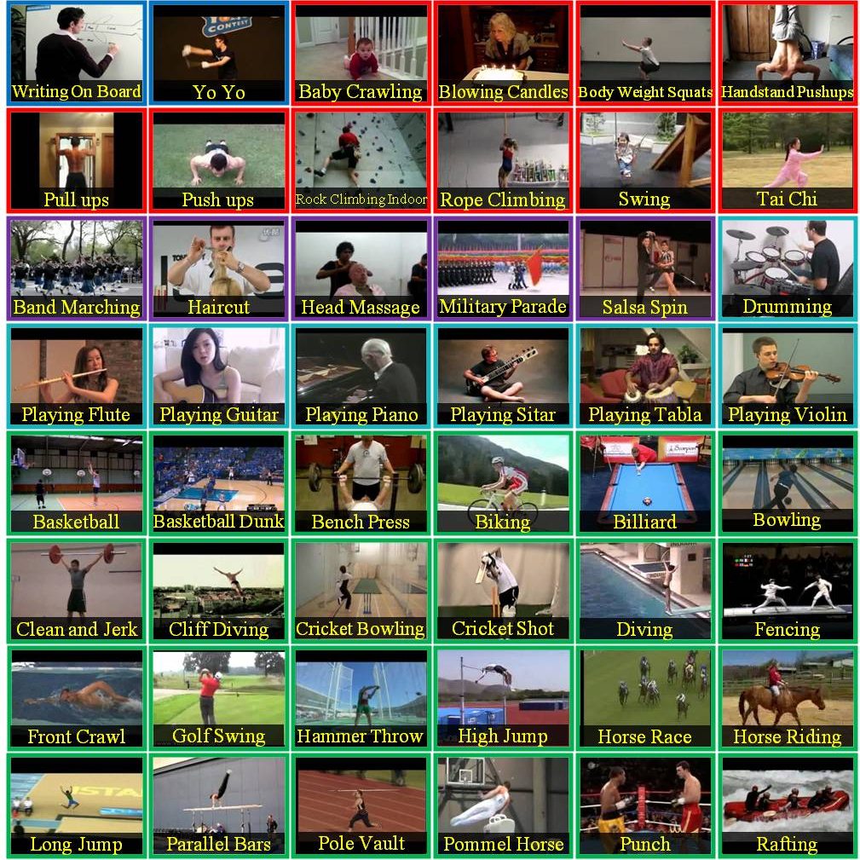
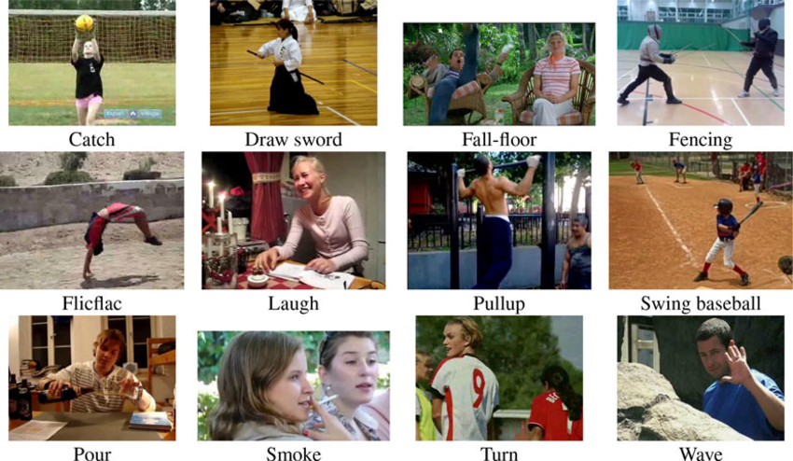
Action Recognition on UCF101 and HMDB51
There are 3.5k/1.5k train/test videos with 51 classes for HMDB51
There are 9.5k/3.7k train/test videos with 101 classes for UCF101
Notes:
Protocol: SSL pretrain on K400 and then freeze the backbone and train a linear classifier on top for UCF/HMDB

Slide 20
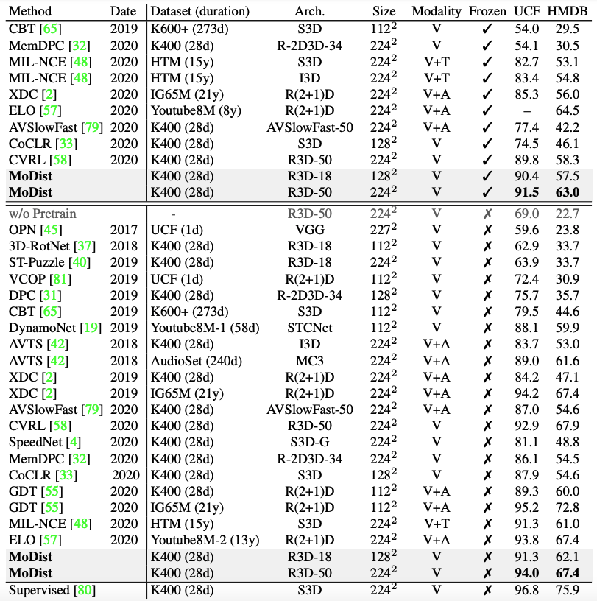
Compare to SOTA methods
We compare to methods use both Linear and Full protocols
We pretrain MoDist for 600 epochs for comparisons

Slide 21
Compare to SOTA methods
We compare to methods use both Linear and Full protocols
With Linear protocol, MoDist achieves better top-1 classification accuracy compared to the previous state-of-the-art trained on K400
Δ = +16.7/+16.9
Δ = +1.7/+4.7
We pretrain MoDist for 600 epochs for comparisons

Slide 22
Compare to SOTA methods
We compare to methods use both Linear and Full protocols
With Linear protocol, MoDist achieves better top-1 classification accuracy compared to the previous state-of-the-art trained on K400
Under Linear protocol, MoDist outperforms methods trained with 100x more data (IG65M and HTM), or use extra modality (audio and text)
We pretrain MoDist for 600 epochs for comparisons

Slide 23
Compare to SOTA methods
We compare to methods use both Linear and Full protocols
With Linear protocol, MoDist achieves better top-1 classification accuracy compared to the previous state-of-the-art trained on K400
Under Linear protocol, MoDist outperforms methods trained with 100x more data (IG65M and HTM), or use extra modality (audio and text)
Under Full protocol, MoDist again achieves SOTA among methods trained on K400. XDC and GDT produce results comparable to MoDist, but are either trained on 270×more data or use extra audio modality as inputs.
We pretrain MoDist for 600 epochs for comparisons

Slide 24
Compare to SOTA methods
We compare to methods use both Linear and Full protocols
With Linear protocol, MoDist achieves better top-1 classification accuracy compared to the previous state-of-the-art trained on K400
Under Linear protocol, MoDist outperforms methods trained with 100x more data (IG65M and HTM), or use extra modality (audio and text)
Under Full protocol, MoDist again achieves SOTA among methods trained on K400. XDC and GDT produce results comparable to MoDist, but are either trained on 270×more data or use extra audio modality as inputs.
Even with a weaker version, MoDist still convincingly outperforms models with similar backbone and input resolutions (e.g., 3D-RotNet, CBT, GDT, CoCLR) and even outperforms many methods that use larger backbones (e.g. XDC, AVSlowFast, etc.).
We pretrain MoDist for 600 epochs for comparisons

Slide 25
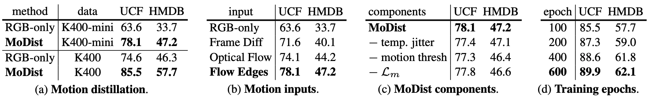
Ablation Studies on UCF101 and HMDB51
+14.6 / +13.5 for UCF / HMDB
+10.9 / +11.4 for UCF / HMDB
We pretrain for 100 epochs and evaluate with Linear protocol for all ablation studies
We test the effectiveness of Motion Distillation by comparing to RGB-only self-supervised baseline.
We vary the size of pretrain dataset, MoDist consistently outperform RGB-only with significant improvements.
MoDist trained on K400-mini already outperforms the RGB baseline trained with 4x more data (K400).
Notes:
Protocol: SSL pretrain on K400 and then freeze the backbone and train a linear classifier on top for UCF/HMDB

Slide 26
Ablation Studies on UCF101 and HMDB51
+14.6 / +13.5 for UCF / HMDB
+10.9 / +11.4 for UCF / HMDB
We evaluate different motion representations.
Flow Edges is indeed the best way to represent motion for self-supervised training, thanks to its ability to prune background motion noise and absolute motion magnitude.
Even the much weaker Frame Difference representation outperforms the RGB-only baseline by +8.0 top-1 accuracy on UCF and +6.4 on HMDB. Again demonstrate the effects of motion distillation.
Notes:
Protocol: SSL pretrain on K400 and then freeze the backbone and train a linear classifier on top for UCF/HMDB

Slide 27
Ablation Studies on UCF101 and HMDB51
+14.6 / +13.5 for UCF / HMDB
+10.9 / +11.4 for UCF / HMDB
It’s beneficial to introduce temporal jittering between RGB and motion clips.
Motion thresholding also helps MoDist training as it avoids sampling clips with weak or no motion cues.
We also confirm the effectiveness of the Motion-to-Motion learning objective.
Notes:
Protocol: SSL pretrain on K400 and then freeze the backbone and train a linear classifier on top for UCF/HMDB

Slide 28
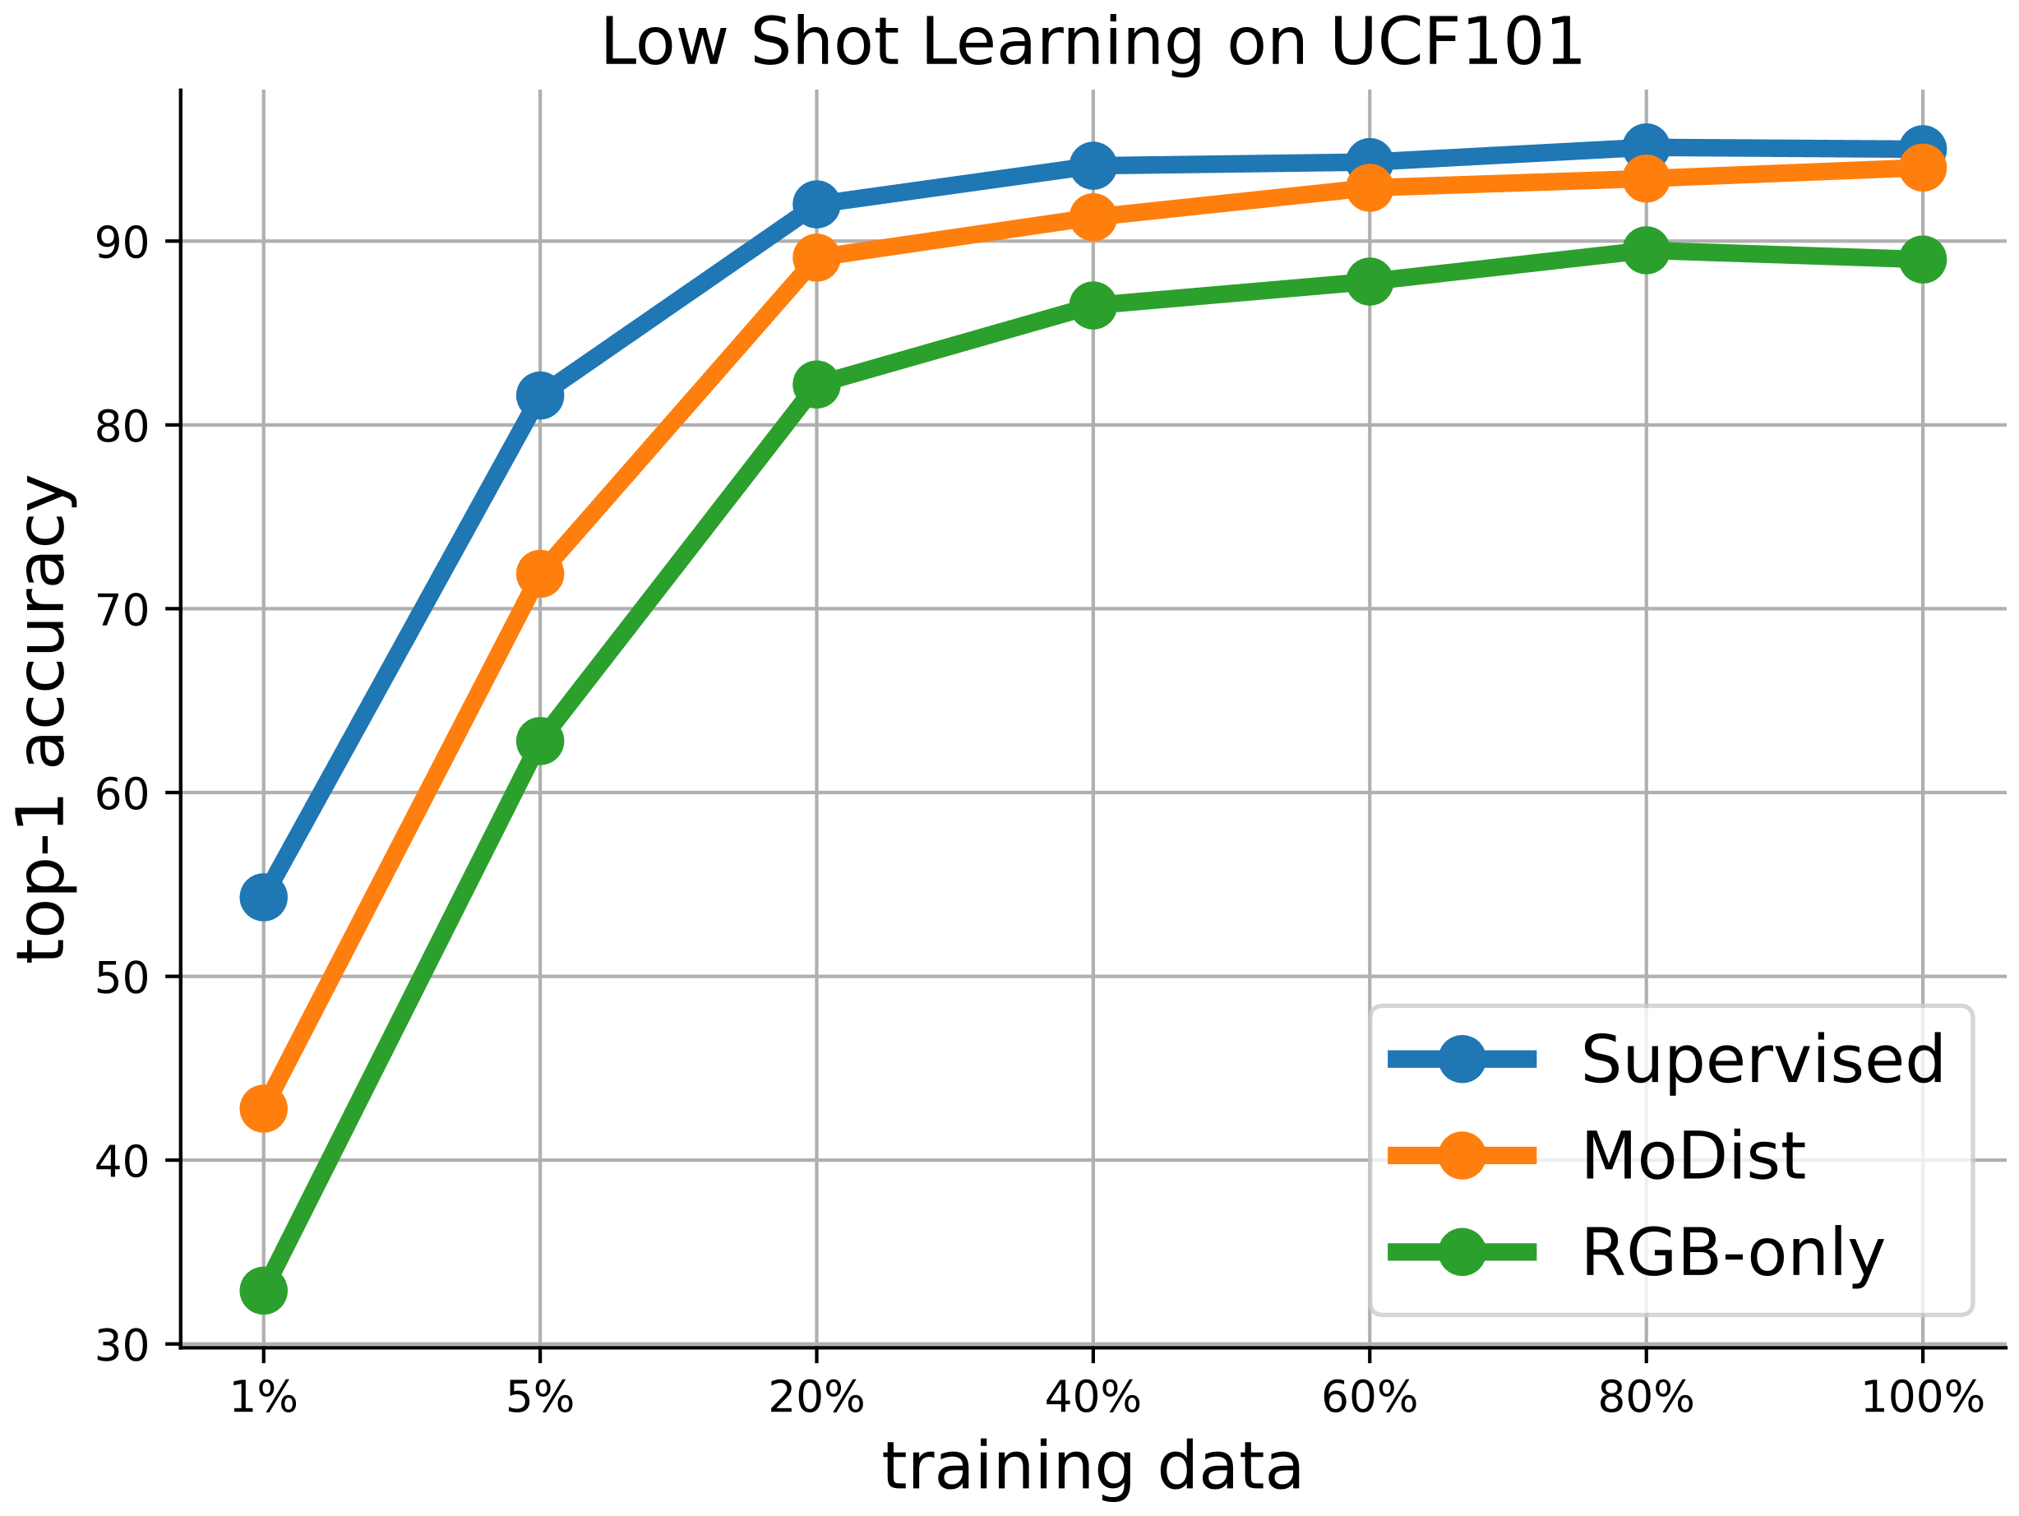
Low-Shot Learning with MoDist Representations
MoDist outperforms RGB-only across all training set sizes and it only requires 20% of the training videos to match the performance of RGB-only with 100%
The gap ∆ between MoDist and RGB-only reaches its maximum with the smallest training set (1%)
We adopt Full Finetune protocol on UCF101
Notes:
This is the first result of generalizing self-supervised video representation to action detection task

Slide 29
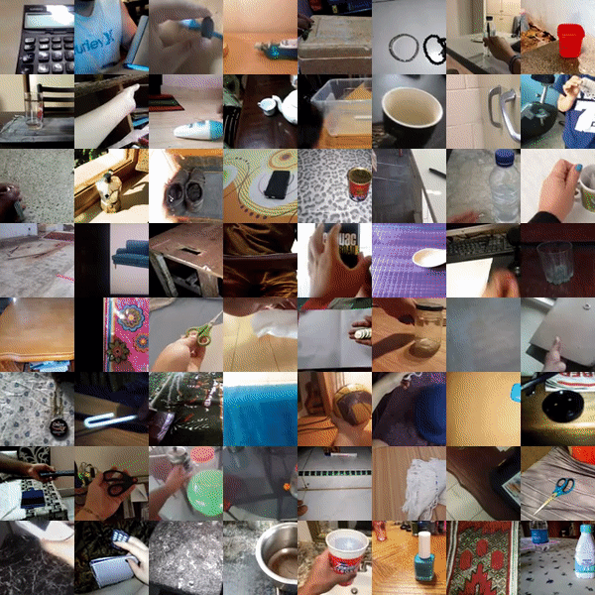
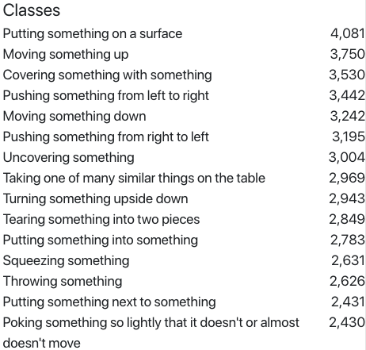
Overcoming Domain Gap: Transfer to Something-Something v2 Recognition
SSv2 contains videos with labels like "Putting [something] onto [something]"
There are 220,847 (168,913 for train) videos with 30,408 unique objects

Slide 30

Overcoming Domain Gap: Transfer to Something-Something v2 Recognition
Method | Pretrain data | Supervision | Top-1 Full | Top-5 Full | Top-1 Linear | Top-5 Linear
R3D-50 | K400 |  | 55.5 | 82.4 | 16.3 | 31.5
Rand Init | N/A | X | 45.4 | 74.8 | - | -
RGB-only | K400 | X | 54.9 | 81.5 | 16.6 | 38.4
MoDist | K400 | X | 57.4 | 83.7 | 27.1 | 53.6
Pretraining is important (+10%)
Gains for motion distillation is generalizable across datasets (+2.5%)
Self-supervised pretraining outperforms supervised pretraining (+1.9%)

Slide 31
Overcoming Domain Gap: Transfer to Something-Something v2 Recognition
Method | Pretrain data | Supervision | Top-1 Full | Top-5 Full | Top-1 Linear | Top-5 Linear
R3D-50 | K400 |  | 55.5 | 82.4 | 16.3 | 31.5
Rand Init | N/A | X | 45.4 | 74.8 | - | -
RGB-only | K400 | X | 54.9 | 81.5 | 16.6 | 38.4
MoDist | K400 | X | 57.4 | 83.7 | 27.1 | 53.6
Unsurprisingly accuracy for all methods are much lower compared to Full protocol.
Performance gain from motion distillation is further increased (+10.5% vs +2.5%).
Supervised baseline underperform both self-supervised methods, as it’s harder to overcome taxonomy bias under Linear protocol compared to the Full protocol for a representation pretrained with a fixed label taxonomy

Slide 32
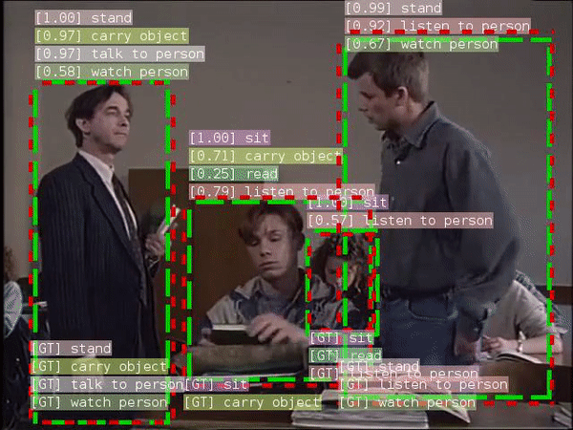
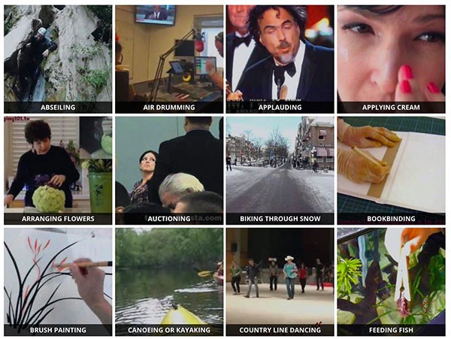
Transfer to AVA detection: Cross-task Generalization of the Video Representations
Transfer Learning
Kinetics
AVA
There is a domain difference when transferring representations learned without any localization annotation to the action detection task

Slide 33
Transfer to AVA detection: Cross-task Generalization of the Video Representations
 | Pretrain data | Supervision | mAP (%)
Video-Faster-RCNN | ImageNet |  | 15.3
Video-Faster-RCNN | K400 |  | 21.9
Random Initialization | N/A | X | 6.6
CVRL [Qian et al. 2021] | K400 | X | 16.3
RGB-only | K400 | X | 18.6
Ours | K400 | X | 22.1
Detector backbone: 8x8 R3D-50 model, mAP is computed on AVA v2.2
Pretraining is critical for AVA detection, as random initialization gives very low accuracy
Proper video pretraining is helpful compared to ImageNet pretraining
MoDist has a consistent gain compared to RGB-only
With Motion Distillation, SSL representation could be as effective as supervised pretraining
Notes:
This is the first result of generalizing self-supervised video representation to action detection task

Slide 34






Visualizing MoDist Representations
MoDist
RGB-only
For each example, we show MoDist visualization in the top row and the visualization of RGB-only model in the bottom row. Predicted class and score are shown on the top-left of each example.

Slide 35






Visualizing MoDist Representations
MoDist
RGB-only
In left two examples, the background scene (gym) is associated with many fine-grained action classes, which leads to confusion for the RGB-only model whereas our MoDist model is able to distinguish actions by focusing on actual motion regions.

Slide 36






Visualizing MoDist Representations
MoDist
RGB-only
In the right two examples, although both models correctly predicted the class, our MoDist model is able to output much more confident prediction scores as it does not get distracted as much by the background.

Slide 37






Visualizing MoDist Representations
MoDist
We demonstrated Motion Distillation can serve as an effective inductive bias for video self-supervised representation learning
We demonstrated the generalization of MoDist across datasets and tasks
Our results suggest MoDist can yield better representation even when compared to fully-supervised training
RGB-only
Note that in these examples, although our model correctly focused on motion regions, it got confused between similar motion patterns (e.g., confusing “Knitting” with “Typing” in the left example).

Slide 38
Thanks!
Questions?
Notes:
Okay, now let's look at an instance of multimodal learning on audiovisual data for the task of video recognition

